Slide 1
The Nigeria eGoverment Scenario
by
Dr Jimson Olufuye
CEO Kontemporary Konsulting Ltd &
Founder/fmr Chair,
Africa ICT Alliance - AfICTA
on the occasion of the
Nigeria eGovernment Summit,
November 17, 2020
Notes:
v

Slide 2
Talking Points
Introduction - Journey thus far
Comparative Digital Economy
Trends
Policy/Laws in place
eGovernment Master Plan
Outcomes
Drawbacks
Conclusion
Notes:
v

Slide 3
Introduction: Journey thus far
Stable democrary since 1999
Effect of Telecom (NCC) Policy 2000 & IT (NITDA) Policy in 2001
Telecom (NCC) Act 2003 & IT (NITDA) Acts of 2007
Freedom of Information Act, 2011
Notes:
v

Slide 4
Institutional Drivers
Federal Ministry of Communications and Digital Economy
NCC: Nigerian Communications Commission (Telecom Regulations)
NBC: National Broadcasting Corporation (Spectrum Management - TV White Space)
NITDA: National IT Development Agency (IT Standards and Regulations)
Government Access Providers: NIGCOMSAT, Galaxy Backbone
Notes:
v

Slide 5
Institutional Drivers
NBS: National Bureau of Statistics
CBN: Central Bank of Nigeria
NIMC: National Identity Management Commission - Digital identity
Notes:
v

Slide 6
Where are we?
Infrastructure
International connectivity
340 GB with a single international submarine cable in 2001
9 Tbit/s by 2012
97.92Tbit/s by 2014
Delivery mostly by mobile broadband - 2.5G (GPRS), EDGE, UMTS, HSPA, HSPA+ and CDMA EV-DO, 3G, 4G/LTE
Services
1Gov.NG services by Galaxy Backbone Plc connecting 4,000 locations & 350 MDAs
Notes:
v

Slide 7
Where are we?
Transformation of erstwhile Ministry of Communications to Ministry of Communications & Digital Economy.
Designation of Telco infrastructure as Critical National Infrastructure meaning govt will provide security and prosecute any deliberate disruption of the telco facilities and operations.
Right of Way fees reduction for Infracos
Virtual meeting now standard in Federal Executive Council meetings
Increasing Online Applications
Notes:
v

Slide 8
Online Applications
CBN: TSA - Treasury Single Account;
OAGF: Office of the Accountant - General for the Federation, IPPIS: Integrated Payroll Payment Information System; GIFMIS: Government Integrated Financial Management Information System. www.gifmis.gov.ng
FIRS: Federal Inland Revenue Service - eTax Clearance Certificate. www.firs.gov.ng
OAuGF: Office of the Auditor-General for the Federation (AuditTracker, Afrrep- Audit Firm Registration and Renewal Portal). www.oaugf.ng
Notes:
v

Slide 9
Online Applications
BVN - Bank Verification Number
JAMB - Online exams for Admission into Nigerian Universities
CAC: Company Registration Portal
NIM: Nigerian Immigration Service, ePassport, eVisa, ePermit
NCS: Nigeria Customs Service, eServices
Health and Welfare▪ Mobile Drug Authentication,
National Health Insurance Scheme (www.nhis.gov.ng)
Driver's License(www.nigeriadriverslicence.org)
Vehicle License(www.nvisng.org)
Notes:
v

Slide 10
Online Applications
Whole of Govt email system
Nigeria Oil & Gas Industry: joint qualification system (portal.nogicjqs.com)
National Identity Card (ninenrol.gov.ng)
Open Data▪ Socio-economic data(www.nigerianstat.gov.ng)
NAFDAC Export Approval (National Agency for Food and Drugs Administration and Control: www.nafdac.gov.ng)
AGIS: Abuja Geographic Information System. www.agis.fcta.gov.ng
Notes:
v

Slide 11
Economic Verdict
ICTs Contribute more than 17% to Nigeria's GDP of USD$446.5b (2019est)
Notes:
v

Slide 12
Comparative Digital Economy Trends/Stats
Notes:
v

Slide 13
Comparative Digital Economy Trends/Stats
Notes:
v

Slide 14
Digital Economy Trends/Stats
Notes:
v

Slide 15
Current Policy Frameworks in place
Nigeria Digital Economy Policy & Strategy for a Digital Nigeria, 2020-2030 launched on 17 October, 2019 by President M. Buhari
VISION: To transform Nigeria into a leading digital economy providing quality life and digital economies for all.
MISSION: We build a nation where digital innovation and entrepreneurship are used to create value and prosperity for all.
Notes:
v

Slide 16
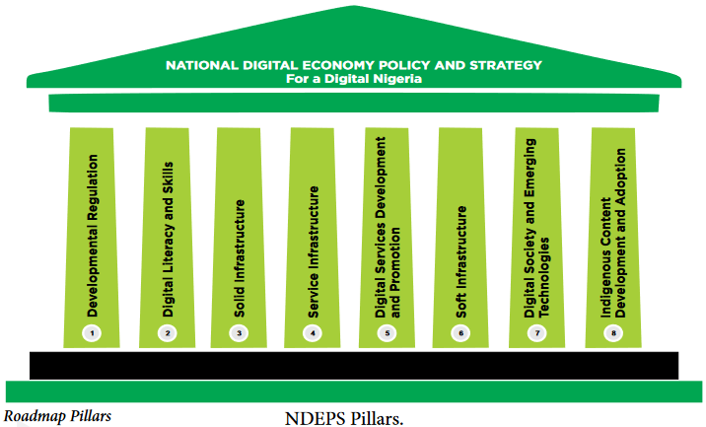
Current Policy Frameworks in place
Nigeria Digital Economy Policy & Strategy for a Digital Nigeria, 2020-2030 is based on 8 pillars namely:
1. Developmental Regulation;
2. Digital Literacy & Skills;
3. Solid Infrastructure;
4. Service Infrastructure;
5. Digital Services Development & Promotion;
Notes:
v

Slide 17
Current Policy Frameworks in place
6. Soft Infrastructure;
7. Digital Society & Emerging Technologies; and
8. Indigenous Content Development & Adoption.
Notes:
v

Slide 18
Current Policy/Law/EOs in place
Nigeria Cybersecurity Policy & Strategy, 2020
The Cybercrime Acts, 2015
Executive Orders 003 and 005 on Ease of doing business to promote G2B, G2G, G2C.
Notes:
v

Slide 19
Current NITDA Guidelines & Frameworks
Guidelines for The Management of Personal Data by Public Institutions in Nigeria, 2020
Guidelines for Nigerian Content Development in Information and Communication Technology (ICT)
Framework and Guidelines for Public Internet Access
Guidelines for Clearance of Information Technology (IT) Project by Public Institutions
Guidelines for Registration of ICT Service Providers/Contractors for Delivery of of IT Services to MDAs
NIgerian Data Protection Regulation (NDPR)
Notes:
v

Slide 20
NITDA Guidelines & Frameworks
Nigeria e-Government Interoperability Framework (Ne-GIF)
Framework and Guidelines for Information and Communication Technology Adoption in Tertiary Institutions
Framework and Guidelines for the Use of Social Media Platforms in Public Institutions
https://nitda.gov.ng/regulations/
Notes:
v

Slide 21
Single Window Portal
http://services.gov.ng
Notes:
v

Slide 22
FMoCDE eGovt Master Plan 2019
The eGovernment Master Plan 2019
is to “Utilize ICT to drive transparency in governance and improve the quality and cost effectiveness of public service delivery in Nigeria”.
Ministry of Communications & Digital Economy
Notes:
v

Slide 23
FMoCDE eGovt Master Plan
Vision
“to create a world class open and digitized government that connects with people to drive efficiency in public administration, responsiveness of civil services and transparency in governance leading to improvement of the quality of life of Nigerians.”
Ministry of Communications & Digital Economy
Notes:
v

Slide 24
FMoCDE eGovt Master Plan
Vision
“to create a world class open and digitized government that connects with people to drive efficiency in public administration, responsiveness of civil services and transparency in governance leading to improvement of the quality of life of Nigerians.”
Ministry of Communications & Digital Economy
Notes:
v

Slide 25
Expected Outcomes
The strategic outcomes from the proposed e-Government Masterplan is a High Performing Government with the following features:
i. High Performance Culture:-
Accountability for performance
Citizen-centric government
An integrated government
ii. Right People:-
Competent, committed, non-corruptible public officers
Public Service as employer of choice
Notes:
v

Slide 26
Expected Outcomes
The strategic outcomes from the proposed e-Government Masterplan is a High Performing Government with the following features:
iii. Responsible Financial Management-
Fiscal Sustainability
Effective and efficient use of financial resources
Notes:
v

Slide 27
Expected Outcomes
e-Government Master Plan Implementation Outcomes is mapped into improvement of the e-Government Development Index and the e-Participation Index. These are measurable impacts that will translate e-Governance from the emerging to the connected stage of development.
Notes:
v

Slide 28
Ministry of Communications & Digital Economy
Notes:
v

Slide 29
Drawbacks
Near zero Govt led WSIS participation (both at the UN & Africa levels)
No ePublic Procurement: lack of transparency and accountability,
No Govt business Workflow - Document Management with workflow
Notes:
v

Slide 30
Drawbacks
Delivery to last mile (TV White Space to the rescue?)
Need for more laws? Don't think so
Notes:
v

Slide 31
Conclusion
Effective eGovernment Implementation would go along way to unlock the Digital Potentials of Nigeria.
Notes:
v

Slide 32
Thank you.
jolufuye@kontemporary.net
Notes:
v

