Slide 1
The Nigeria e-Government Summit 2020
17th November 2020
Case Study: The State of e-Government and critical success factors in Kenya
Dr. Waudo Siganga

Slide 2

Kenya at a Glance
GDP 2019 US$ 97.4B
Average GDP Per Capita US$ 2,047
Indic. Exchange rate: 1US$=110 Kshs.
Population 47m (29th most populous)
0-14: 40.2%
15-35: 35%
63-46: 21.98%
65>: 3%
Official Language: English
Political System: Devolved State with Multi-Party democracy; 47 Counties
Climate: Equatorial with climate ranging from tropical to 10-35 degrees centigrade

Slide 3
Objectives
The overall goal of e-Government in Kenya is to make the Government more result oriented, efficient and citizen centred. E-Government should enable citizens to access Government Services and Information as efficiently and as effectively as possible through the use of internet and other channels of communication.
24/7 Access to Services
Reduction in costs of the Services
Ease of payment for services
Reduction in human to human interaction and corruption
Easier, more effective feedback

Slide 4

Major Applications & Services

Slide 5
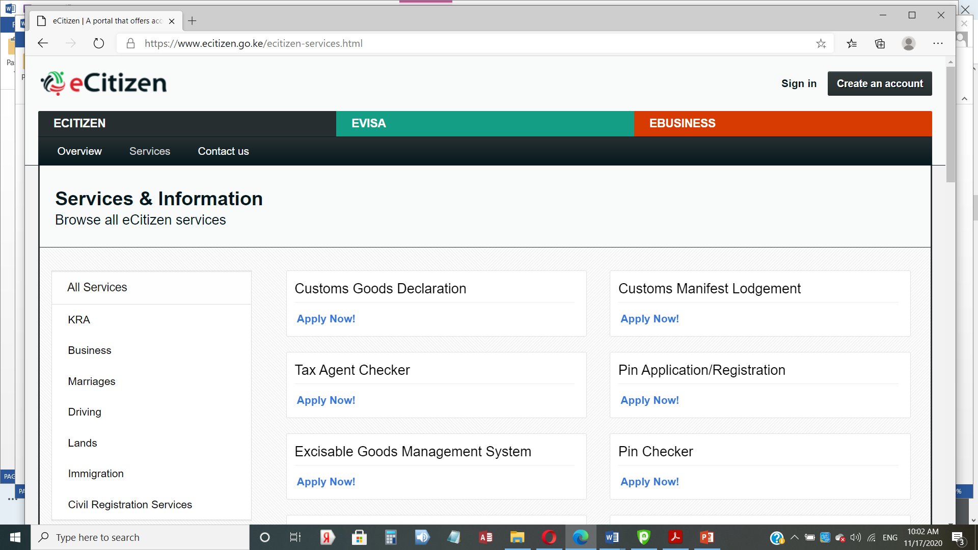
Major Applications

Slide 6
Key Success Factors
Should be run at high level – Directorate positioned in the Office of the President
Supportive ICT Infrastructure/service availability (especially in rural)
Supportive policies and regulation
Training government officials
User Awareness and buy in

Slide 7
END
Thank You

